Slide 1

Nelson Mandela
Nelson Mandela's date of birth is July 18, 1918, and his date of death is December 5, 2013. He died at the age of 95.

Slide 2
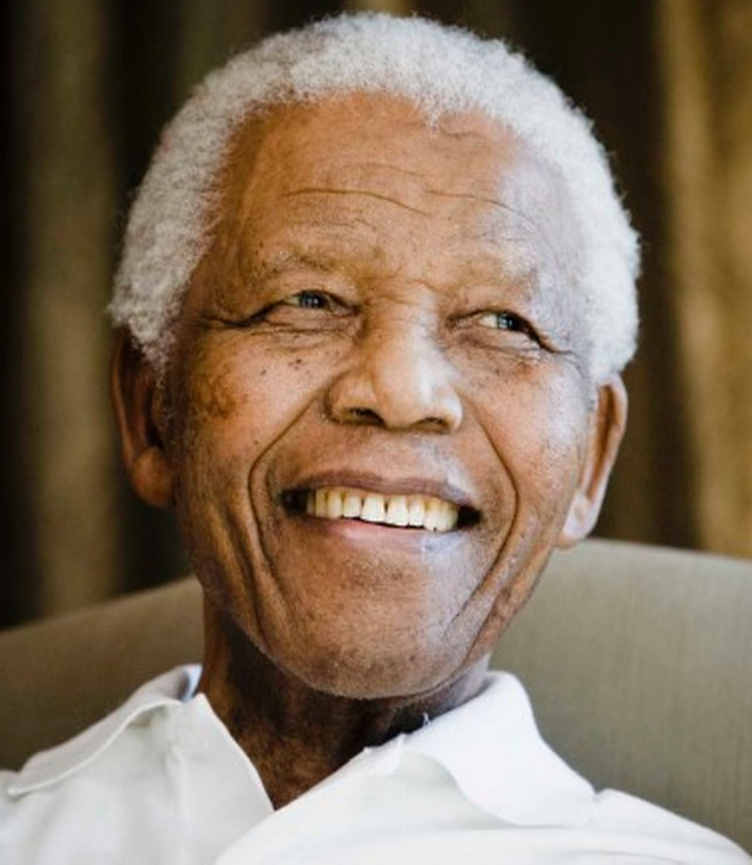
Nelson Mandela's life and his dedication to education were crucial for his leadership and his fight against apartheid. His education, both formal and informal, allowed him to understand and address the injustices of apartheid, ultimately leading to its dismantling and a more just South Africa. Mandela's commitment to lifelong learning, even in prison, further solidified his ability to lead and inspire others.
This Photo by Unknown Author is licensed under CC BY

Slide 3
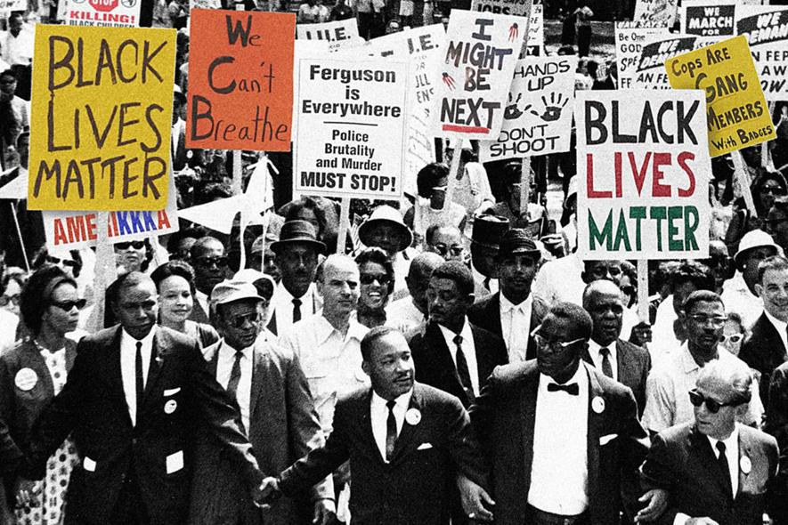
How did Mandela fight against Apartheid rules?
Nelson Mandela played a significant role in dismantling apartheid through various strategies, including non-violent protests, forming the militant wing of the ANC (Umkhonto we Sizwe), international activism, and ultimately, negotiations with the government.

Slide 4
1. Non-violent Protest and Activism:
Joining the ANC:
Mandela became a key figure in the African National Congress (ANC), which advocated for the rights of Black South Africans.
ANC Youth League:
He helped establish and lead the ANC Youth League, a youth wing focused on raising awareness and challenging apartheid laws.
Defiance Campaign:
Mandela played a crucial role in the Defiance Campaign of 1952, encouraging Black people to violate apartheid laws.
International Activism:
After his arrest, Mandela's name became synonymous with the struggle against apartheid, and international pressure mounted to release him and end apartheid.

Slide 5
2. Armed Struggle:
Umkhonto we Sizwe:
In 1961, Mandela co-founded Umkhonto we Sizwe ("Spear of the Nation"), a military wing of the ANC, which engaged in sabotage against the apartheid government.
Underground Activities:
Mandela spent 17 months underground, trying to gain support for the armed struggle, but was arrested in 1962.
Sentenced to Life:
He and seven colleagues were sentenced to life in prison in 1963, further solidifying his status as a symbol of resistance.

